Slide 1



Electronic configuration of atoms. Pauli's principle, Hund's rule, minimum energy principle, Kleczkowski's rule.
Al-Farabi Kazakh National University
Faculty of Chemistry and Chemical technology
Department of General and Inorganic Chemistry
pHd Bakhadur askar

Slide 2
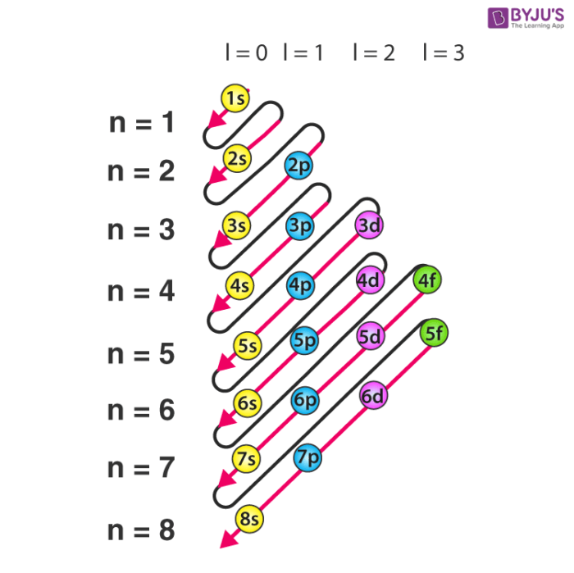
Electronic Configuration
Electronic configuration describes the distribution of electrons in an atom’s orbitals. It helps explain the atom’s chemical behavior and properties. Electrons occupy atomic orbitals in a way that minimizes energy and follows specific quantum mechanical rules.

Slide 3
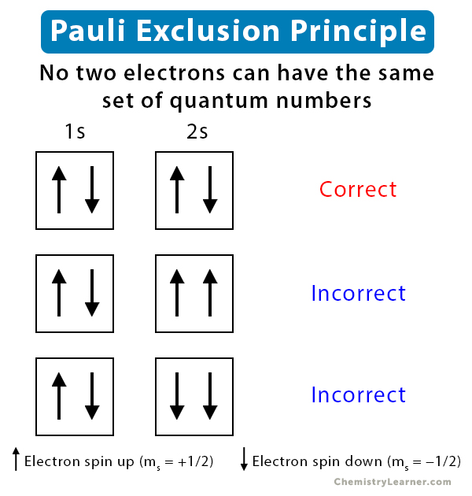
Pauli's Exclusion Principle
Formulated by Wolfgang Pauli in 1925, this principle states: No two electrons in an atom can have the same set of four quantum numbers.
Each orbital can hold a maximum of two electrons.
These electrons must have opposite spins (spin quantum number +½ and −½). This principle explains the unique identity of each electron and the structure of electron shells.

Slide 4
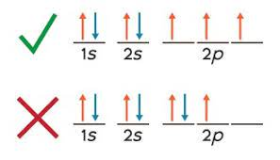
Hund’s Rule
Hund’s rule states that electrons occupy degenerate orbitals (orbitals of the same energy) singly first, with parallel spins, before pairing up.
This minimizes electron-electron repulsion and stabilizes the atom.
Example: In the p subshell (3 orbitals), electrons fill one in each orbital before any pairing. Hund’s rule is crucial for predicting magnetic properties and electron arrangement.

Slide 5
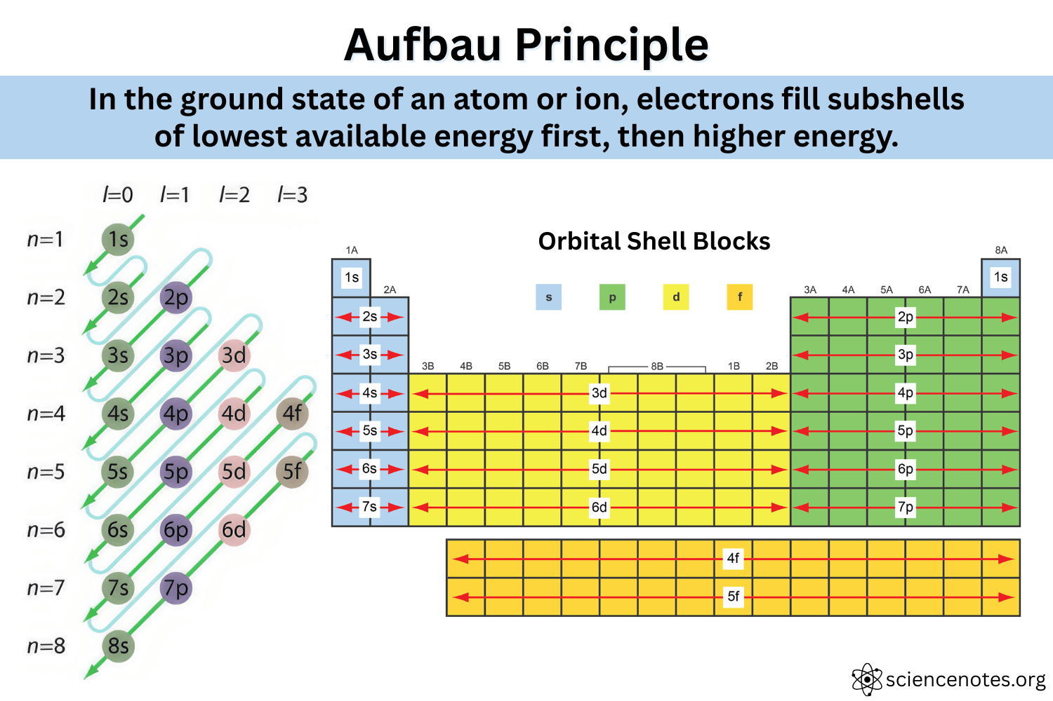
Minimum Energy Principle (Aufbau Principle)
Also called the Aufbau principle, it states that electrons fill orbitals starting from the lowest energy level to higher ones.
Electrons occupy the lowest available energy orbitals first to minimize the total energy of the atom.
The order is generally: 1s → 2s → 2p → 3s → 3p → 4s → 3d → 4p → … This principle guides the stepwise filling of electron shells.

Slide 6
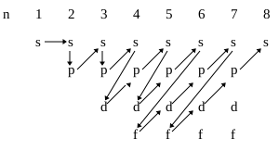
Kleczkowski’s Rule (n + l Rule)
Kleczkowski’s rule provides a method to determine the order of orbital filling based on the sum of the principal quantum number (n) and azimuthal quantum number (l).
Orbitals with lower (n + l) values fill first.
If two orbitals have the same (n + l) value, the one with lower n fills first.
Example: 4s (n=4, l=0, sum=4) fills before 3d (n=3, l=2, sum=5). This rule refines the understanding of energy order in electron configurations.

Slide 7
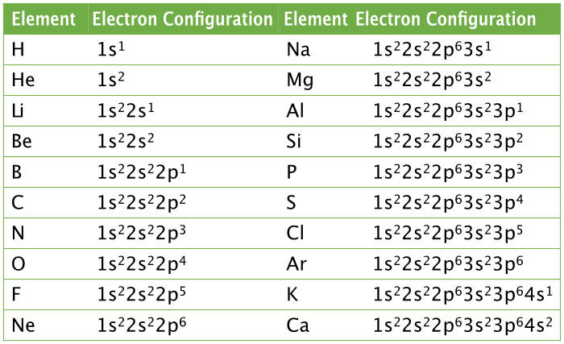
Examples of Electronic Configurations

Slide 8
Application
Understanding electronic configuration is vital for:
Predicting chemical reactivity and bonding
Explaining periodic trends like atomic radius, ionization energy, and electronegativity
Designing materials and understanding magnetic/electrical properties
This knowledge is foundational in chemistry, physics, and material science.

Slide 9
Summary
Pauli’s principle restricts electron spin combinations in orbitals.
Hund’s rule governs electron distribution in degenerate orbitals.
Minimum energy principle dictates electron filling order.
Kleczkowski’s rule refines orbital energy order by quantum numbers.
Together, these principles explain the complex but orderly nature of atomic structure.

Slide 10

Questions?

